Slide 1
FULLSTACK
Backend Programming

Slide 2
Switch

Slide 3
Switch
A switch statement is a shorter way to write a sequence of if - else statements.
It runs the first case whose value is equal to the condition expression.

Slide 4
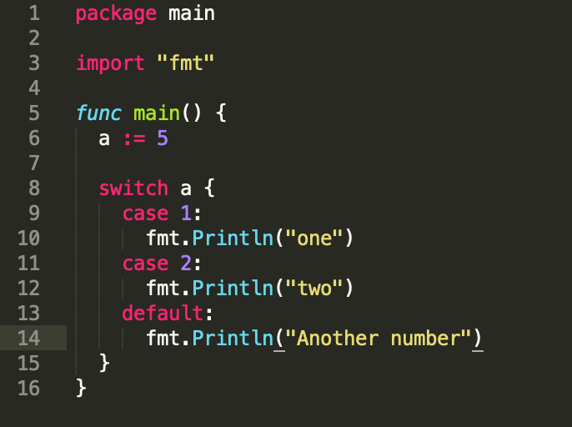
Switch

Slide 5

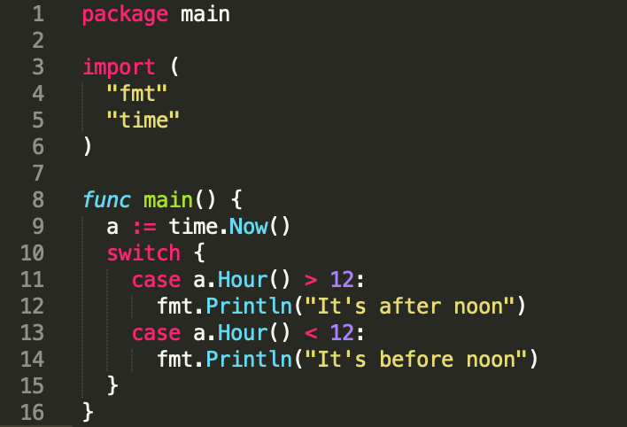
Let’s try !
I want to know the time is after noon or before noon with using switch. Input : 14 Output : It’s after noon Input : 9 Output : It’s before noon

Slide 6
Array

Slide 7
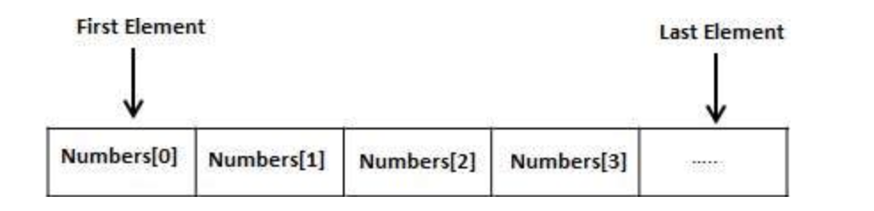
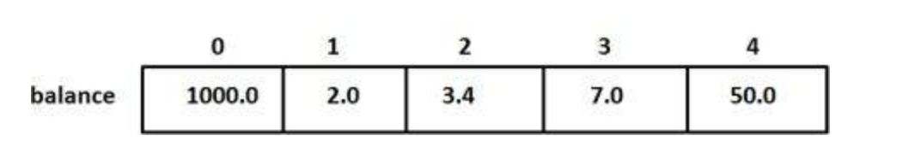
Array

Slide 8


Array - Declaration
n -> Array of length
T -> Type

Slide 9
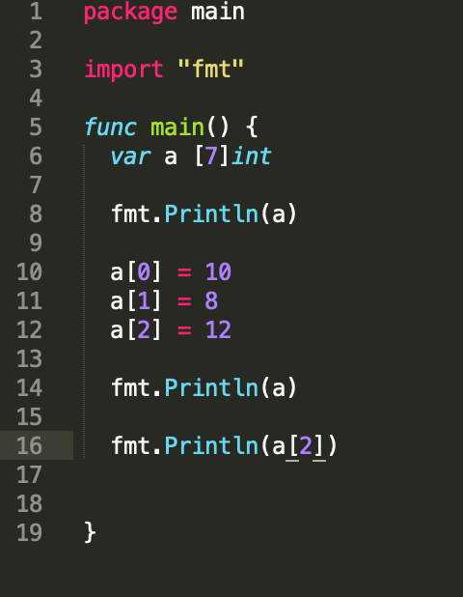
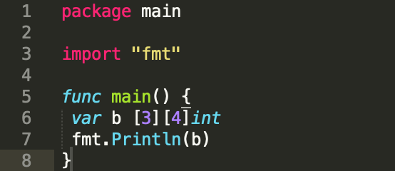
Array

Slide 10
Let’s try !
There are 5 indexes that have some value : 8,1,7,9,3. Print the value of index 4

Slide 11
For Loop

Slide 12
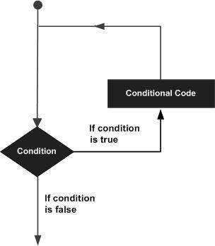
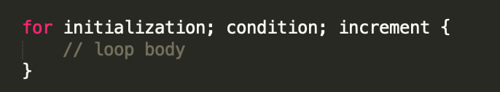
For Loop

Slide 13
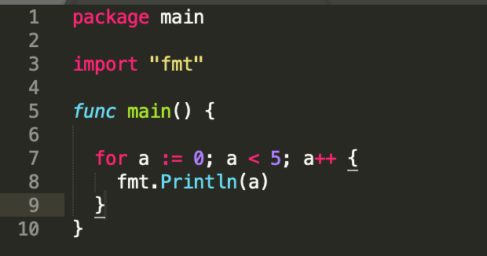
For Loop

Slide 14
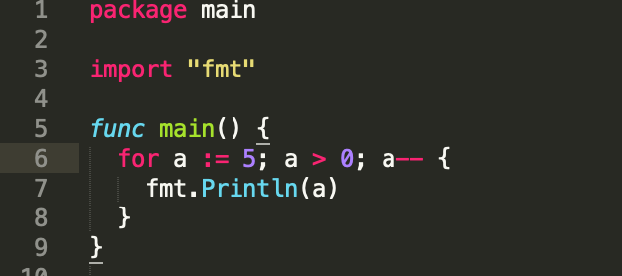
For Loop

Slide 15
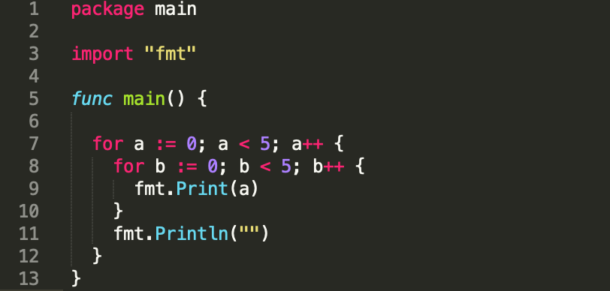
For Loop

Slide 16
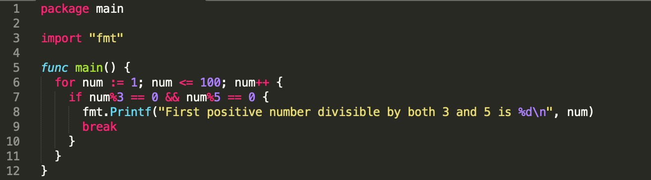
For Loop – Break Statement
Break statement is used to break out of a loop before it’s normal termination.

Slide 17
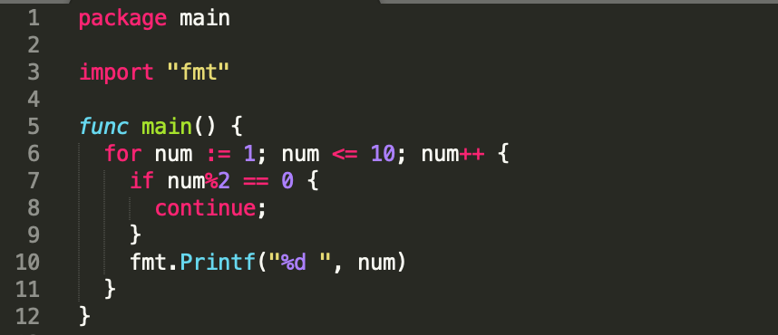
For Loop – Continue Statement
Continue statement is used to stop running the loop body midway and continue to the next iteration of the loop.

Slide 18
Slice

Slide 19
Slice
Slice is a segment on array.
Slice build on array and provide more: - power - flexibility - convenience If it compared to array
Slices are indexable and have a length
Slice is like an array but unlike an array. Because they can be resized
Slice is just a reference to an underlying array

Slide 20
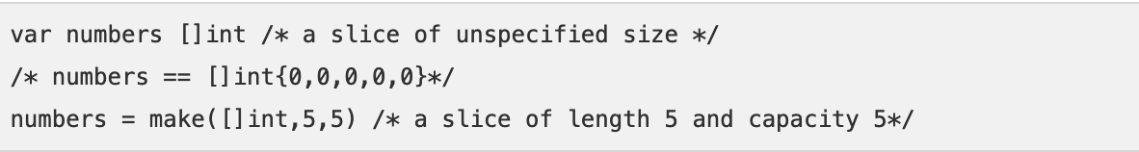
Slice – Declaration & Initialization
use make function to create a slice.
Notes:
To define a slice, you can declare it as an array without specifying its size

Slide 21
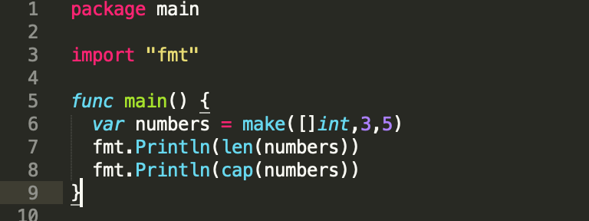
Slice - Two Function
len()
len is how many items are in the array.
cap()
cap is the capacity of the underlying array

Slide 22
Slice - cap
0 <= len <= cap
If the value of len and cap are equals to 0, the the second cap is len + 1
For example :
var numbers []int
fmt.Println("value = ", numbers, ", len = ", len(numbers), ", cap = ", cap(numbers))
numbers = append(numbers, 2,3,4)
fmt.Println("value = ", numbers, ", len = ", len(numbers), ", cap = ", cap(numbers))

Slide 23

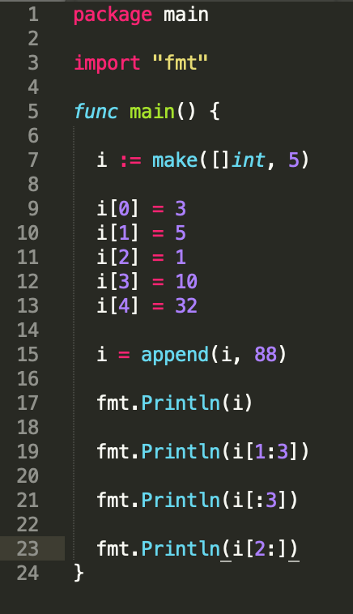
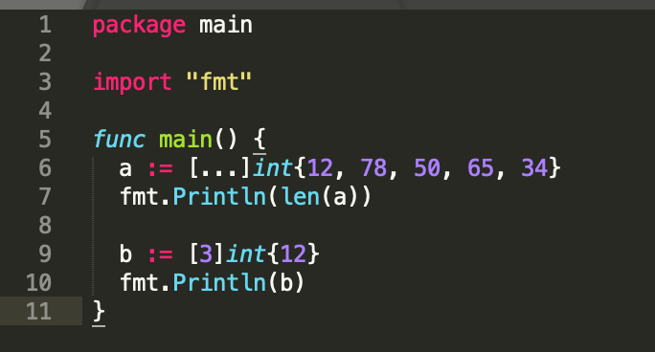
Slice

Slide 24
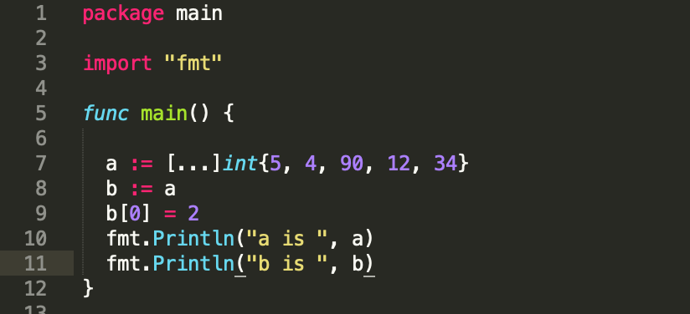
Let’s guess it !

Slide 25
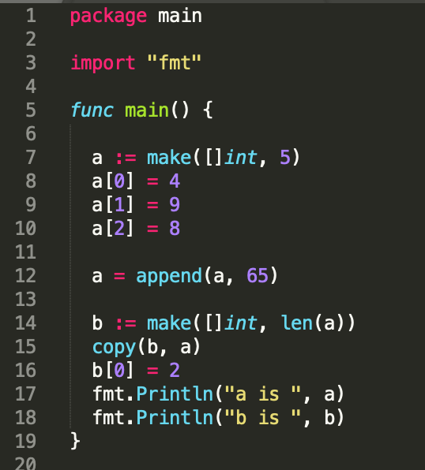
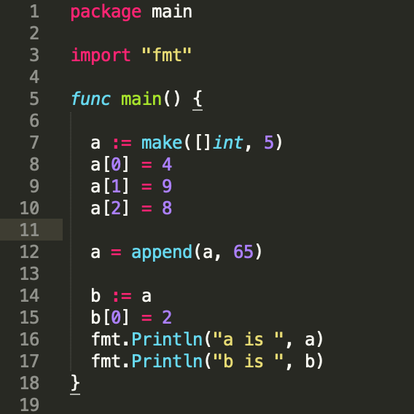
Let’s guess it !

Slide 26
Summary
Switch
Array
Loop
Slice

Slide 27


